Slide 1
Design and Analysis of Algorithms Single-source shortest paths, all-pairs shortest paths
Slides from: Haidong Xue and Dr. Fethi Jarray
Provided By: Muhammad Atif Tahir
Presented by: Waheed Ahmed

Slide 2
Shortest-Path Problems
Single-source. Find a shortest path from a given source to each of the vertices
Single-pair. Given two vertices, find a shortest path between them. Solution to single-source problem solves this problem efficiently, too
All-pairs. Find shortest-paths for every pair of vertices

Slide 3
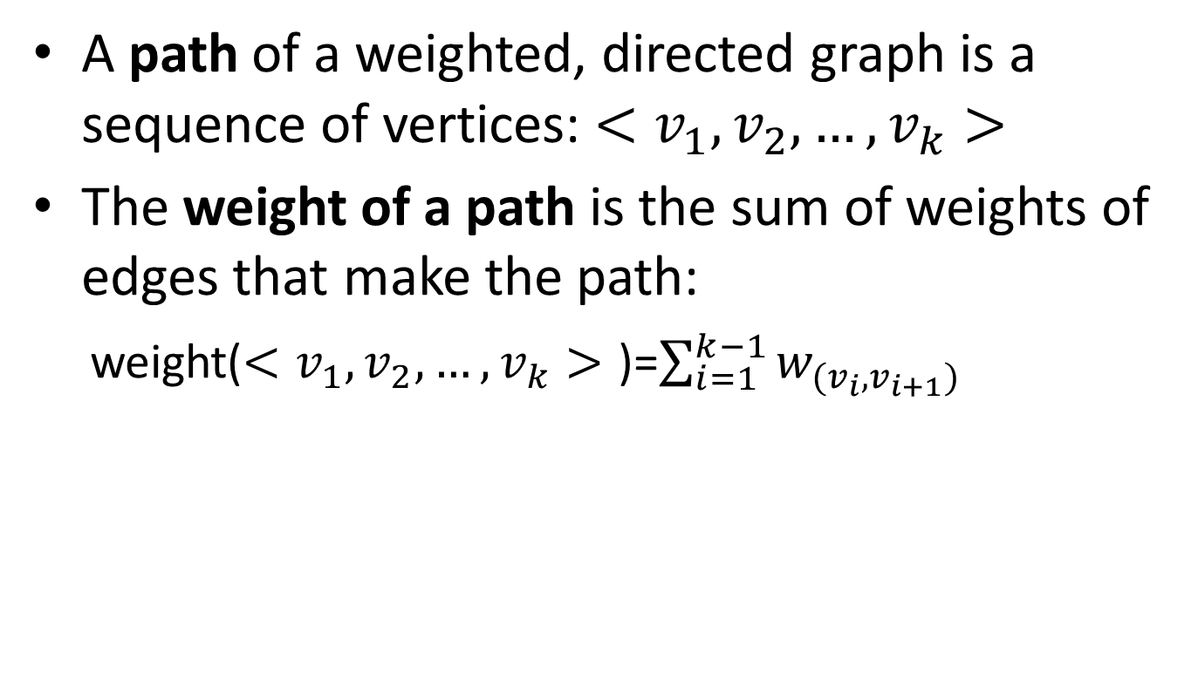
Single-source shortest paths
A path of a weighted, directed graph is a sequence of vertices: $<v_{1},v_{2}, …,v_{k}>$
The weight of a path is the sum of weights of edges that make the path:
weight($<v_{1},v_{2}, …,v_{k}>$ )=$\sum_{i=1}^{k−1}{w_{(v_{i},v_{i+1})}}$

Slide 4
Single-source shortest paths
1
2
3
10
3
2
9
1
6
4
5
7
4
5
2
Given this weighted, directed graph, what is the weight of path: <1, 2, 4>?
10+2=12

Slide 5
Single-source shortest paths
1
2
3
10
3
2
9
1
6
4
5
7
4
5
2
Given this weighted, directed graph, what is the weight of path: <1, 2, 4, 2, 4>?
10+2 + 3 + 2 = 17

Slide 6
Single-source shortest paths
1
2
3
10
3
2
9
1
6
4
5
7
4
5
2
Given this weighted, directed graph, what is the weight of path: <1, 2, 4, 1>?
10 + 2 + $∞$ = $∞$

Slide 7
Single-source shortest paths
1
2
3
10
3
2
9
1
-6
4
5
7
4
5
2
Given this weighted, directed graph, what is the weight of path: <5, 3, 5> and <5, 3, 5, 3, 5>??
4-6 = -2 and -6+4-6+4 = -4
Negative cycle
There is no shortest path from 3 to 5

Slide 8
NEGATIVE CYCLES
If negative cycles exist in the graph, we’ll say no solution exists. Why?
C
-1
-4
A
B
D
E
2
3
5
What’s the shortest path from A to E?
Is it: A → B → C → D → E? Cost = 2 - 1 - 4 + 5 = 2.

Slide 9
Single-source shortest paths
Shortest path of a pair of vertices <u, v>: a path from u to v, with minimum path weight
Applications:
Your GPS navigator
If weights are time, it produces the fastest route
If weights are gas cost, it produces the lowest cost route
If weights are distance, it produces the shortest route

Slide 10
Single-source shortest paths
Single-source shortest path problem: given a weighted, directed graph G=(V, E) with source vertex s, find all the shortest (least weight) paths from s to all vertices in V.

Slide 11
Single-source shortest paths
Two classic algorithms to solve single-source shortest path problem
Bellman-Ford algorithm
A dynamic programming algorithm
Works when some weights are negative
Dijkstra’s algorithm
A greedy algorithm
Faster than Bellman-Ford
Works when weights are all non-negative

Slide 12

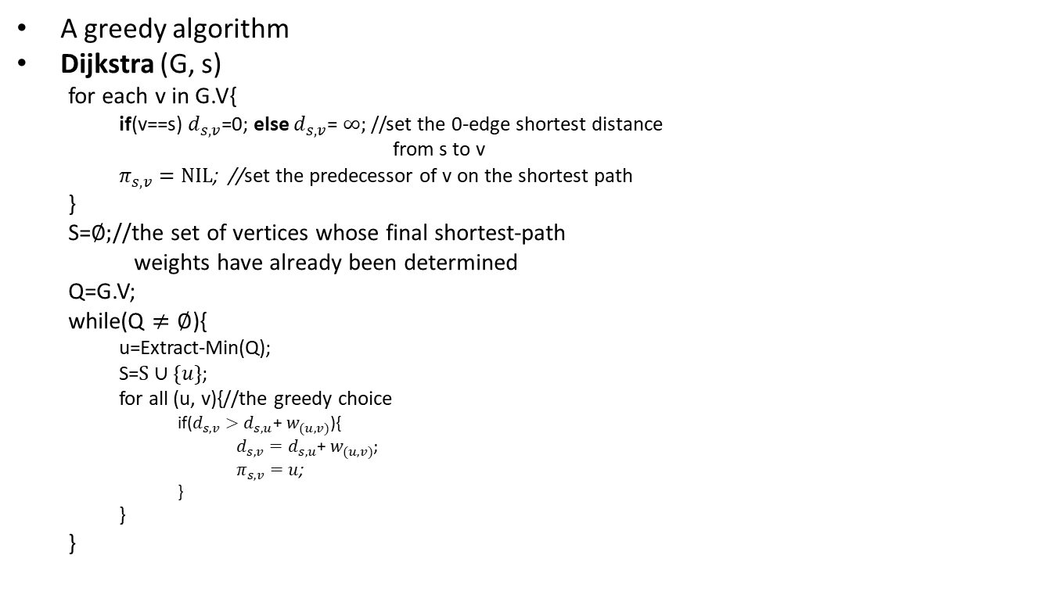
Dijkstra’s Algorithm (Pseudocode 1)
A greedy algorithm
Dijkstra (G, s)
for each v in G.V{
if(v==s) $d_{s,v}$=0; else $d_{s,v}$= $∞;$//set the 0-edge shortest distance
from s to v
$π_{s,v}=NIL$; //set the predecessor of v on the shortest path
}
S=$∅;$//the set of vertices whose final shortest-path
weights have already been determined
Q=G.V;
while(Q $≠∅$){
u=Extract-Min(Q);
S=$S∪\{u\}$;
for all (u, v){//the greedy choice
if($d_{s,v}>d_{s,u}$+ $w_{(u,v)}$){
$d_{s,v}=d_{s,u}\text{+ }w_{(u,v)}$;
$π_{s,v}=u$;
}
}
}
T(n)=O($V^{2}$)

Slide 13
Dijkstra’s Algorithm (Pseudocode 2)
dist[s] ←0 (distance to source vertex is zero) for all v ∈ V–{s} do dist[v] ←∞ (set all other distances to infinity) S←∅ (S, the set of visited vertices is initially empty) Q←V (Q, the queue initially contains all vertices) while Q ≠∅ (while the queue is not empty) do u ← mindistance(Q,dist) (select the element of Q with the min. distance) S←S ∈{u} (add u to list of visited vertices) for all v ∈ neighbors[u] do
dist[v]= min(dist[v], dist[u] + w(u, v)) (update distance)
return dist

Slide 14
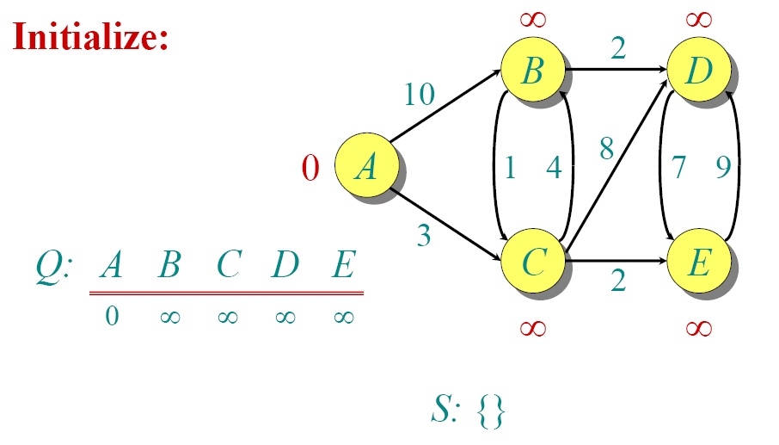
Dijkstra Example
dist[s] ←0 for all v ∈ V–{s} do dist[v] ←∞ S←∅ Q←V

Slide 15
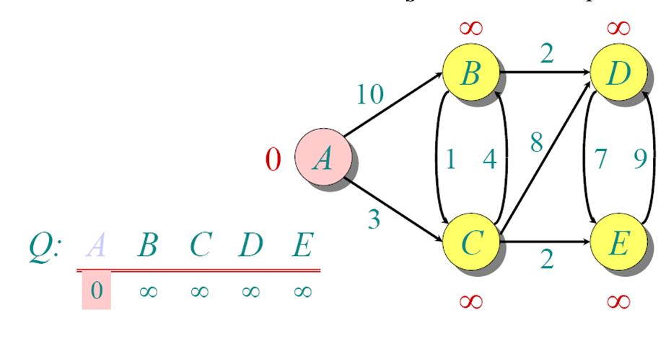
Dijkstra Example
dist[s] ←0 for all v ∈ V–{s} do dist[v] ←∞ S←∅ Q←V

Slide 16
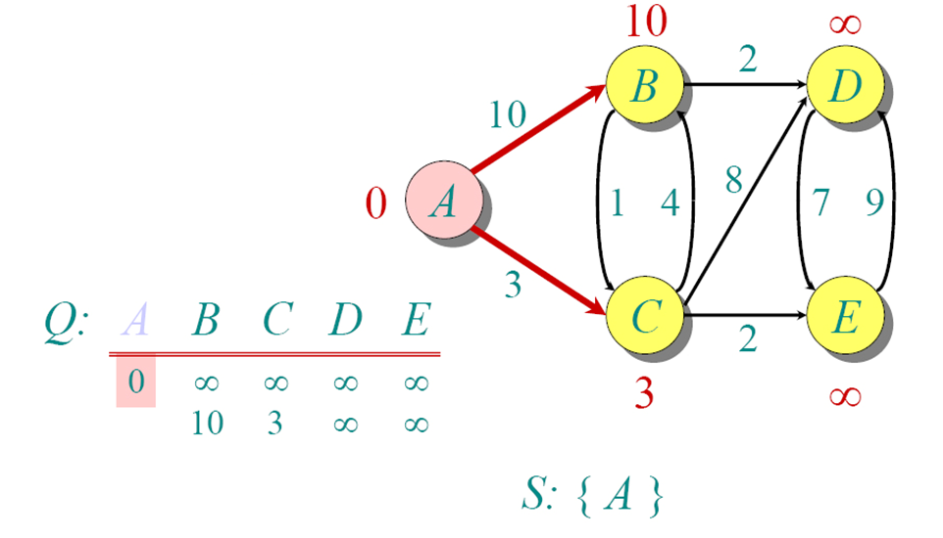
Dijkstra Example
while Q ≠∅ do u ← mindistance(Q,dist) S←S ∈{u} for all v ∈ neighbors[u] do
dist[v]= min(dist[v], dist[u] + w(u, v))
return dist
dist[s] ←0 for all v ∈ V–{s} do dist[v] ←∞ S←∅ Q←V

Slide 17
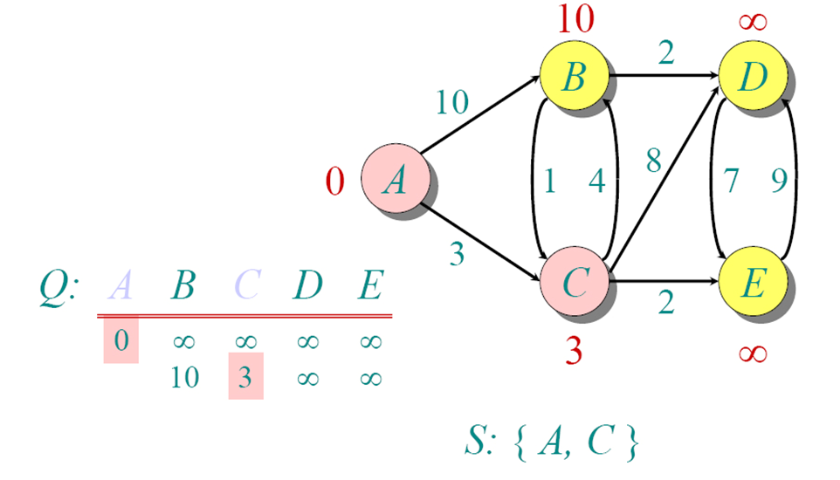
Dijkstra Example
while Q ≠∅ do u ← mindistance(Q,dist) S←S ∈{u} for all v ∈ neighbors[u] do
dist[v]= min(dist[v], dist[u] + w(u, v))
return dist

Slide 18
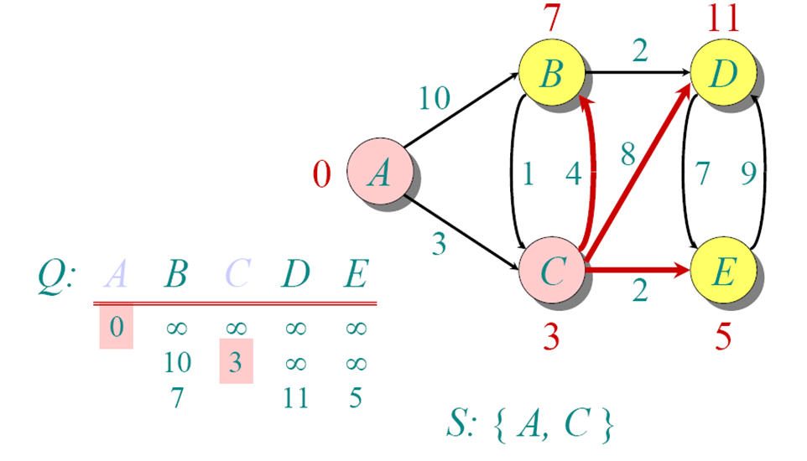
Dijkstra Example
while Q ≠∅ do u ← mindistance(Q,dist) S←S ∈{u} for all v ∈ neighbors[u] do
dist[v]= min(dist[v], dist[u] + w(u, v))
return dist

Slide 19
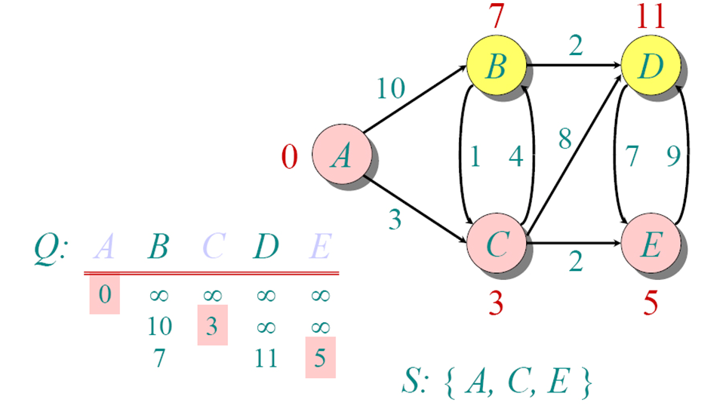
Dijkstra Example
while Q ≠∅ do u ← mindistance(Q,dist) S←S ∈{u} for all v ∈ neighbors[u] do
dist[v]= min(dist[v], dist[u] + w(u, v))
return dist

Slide 20
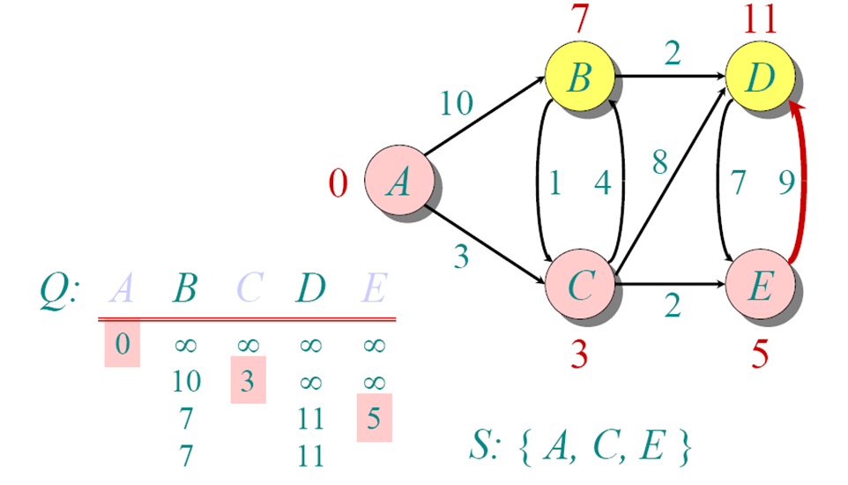
Dijkstra Example
while Q ≠∅ do u ← mindistance(Q,dist) S←S ∈{u} for all v ∈ neighbors[u] do
dist[v]= min(dist[v], dist[u] + w(u, v))
return dist

Slide 21
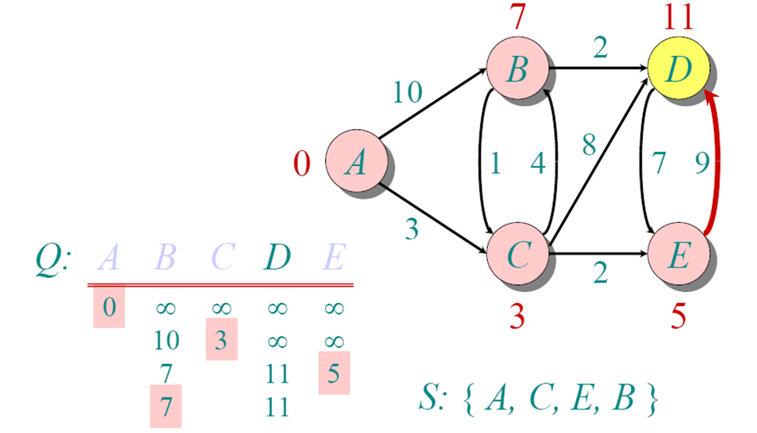
Dijkstra Example
while Q ≠∅ do u ← mindistance(Q,dist) S←S ∈{u} for all v ∈ neighbors[u] do
dist[v]= min(dist[v], dist[u] + w(u, v))
return dist

Slide 22
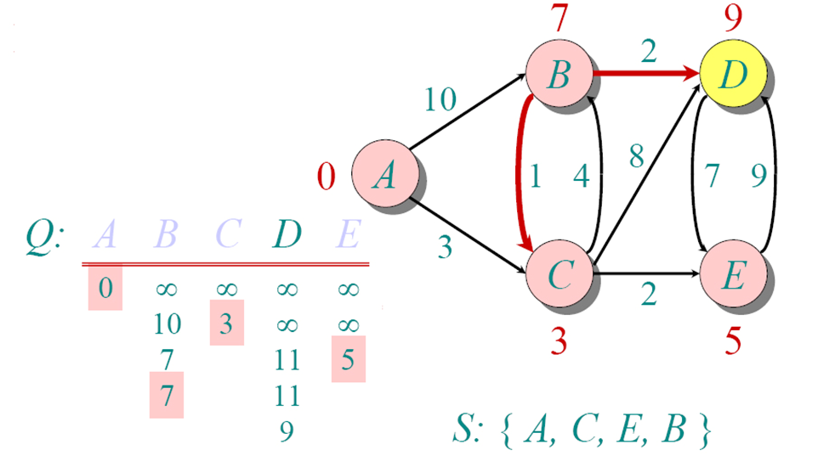
Dijkstra Example
while Q ≠∅ do u ← mindistance(Q,dist) S←S ∈{u} for all v ∈ neighbors[u] do
dist[v]= min(dist[v], dist[u] + w(u, v))
return dist

Slide 23
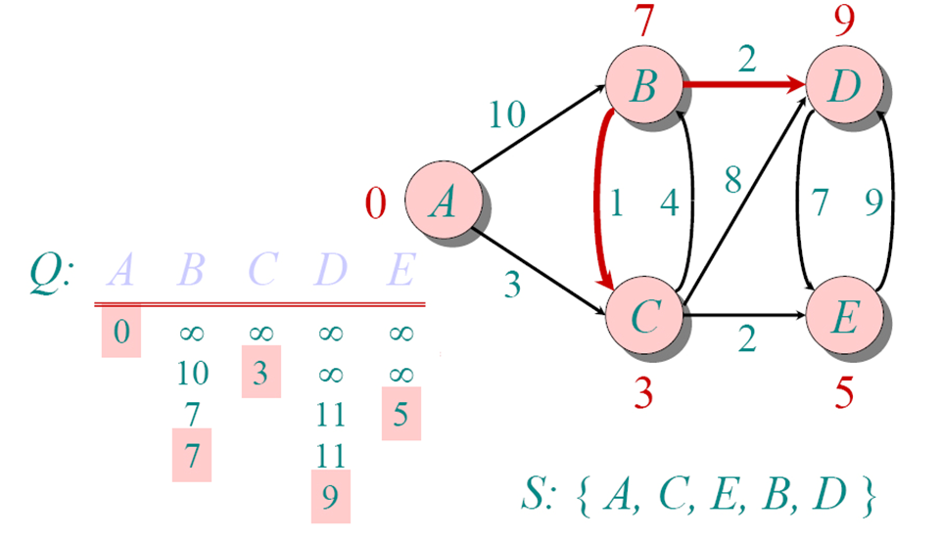
Dijkstra Example
while Q ≠∅ do u ← mindistance(Q,dist) S←S ∈{u} for all v ∈ neighbors[u] do
dist[v]= min(dist[v], dist[u] + w(u, v))
return dist

Slide 24
Dijkstra’s algorithm Running Time
Initialization : Θ(V)
|V| iterations
Each iteration: Θ(V)
Total time: O(V²)

Slide 25
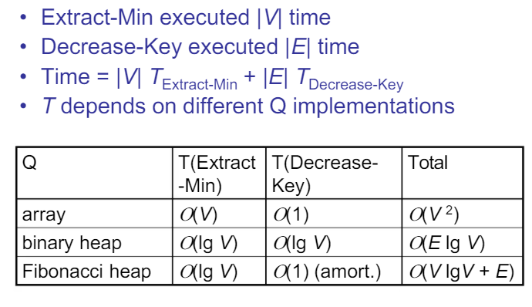
Dijkstra’s algorithm Running Time
Decrease key means: update better (lower) value
Binary heap: O( (V + E) log V)

Slide 26
Dijkstra’s algorithm Running Time
Constructs the initial priority queue performs the insert operation V times, resulting in performance O(V log V).
In the remaining while loop, each edge is visited once, so decreaseKey is called atmost E times = O(E log V) time.
Overall Binary heap: O( (V + E) log V)

Slide 27
Dijkstra’s Algorithm (Pseudocode 2)
dist[s] ←0 for all v ∈ V–{s} do dist[v] ←∞
prev [v] = nil S←∅ Q←V // Make Queue using distance values as key while Q ≠∅ do u ← mindistance(Q,dist) S←S ∈{u} DeleteMin or ExtractMin for all v ∈ neighbors[u] do
dist[v]= min(dist[v], dist[u] + w(u, v))
return dist
If dist[v] > dist[u] + w(u, v)
dist[v] = dist[u] + w(u, v)
prev [v] = u
decreaseKey(Q, v)
dist[v]= min(dist[v], dist[u] + w(u, v))

Slide 28
Bellman-Ford algorithm
Observation:
If there is a negative cycle, there is no solution
Add this cycle again can always produces a less weight path
If there is no negative cycle, a shortest path has at most |V|-1 edges
Idea:
Solve it using dynamic programming
For all the paths have at most 0 edge, find all the shortest paths
For all the paths have at most 1 edge, find all the shortest paths
…
For all the paths have at most |V|-1 edge, find all the shortest paths

Slide 29

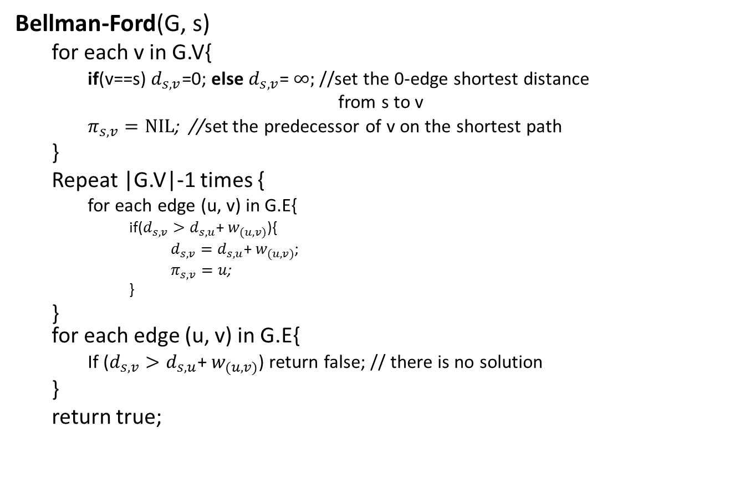
Bellman-Ford algorithm
Bellman-Ford(G, s)
for each v in G.V{
if(v==s) $d_{s,v}$=0; else $d_{s,v}$= $∞;$//set the 0-edge shortest distance
from s to v
$π_{s,v}=NIL$; //set the predecessor of v on the shortest path
}
Repeat |G.V|-1 times {
for each edge (u, v) in G.E{
if($d_{s,v}>d_{s,u}$+ $w_{(u,v)}$){
$d_{s,v}=d_{s,u}\text{+ }w_{(u,v)}$;
$π_{s,v}=u$;
}
} for each edge (u, v) in G.E{
If ($d_{s,v}>d_{s,u}$+ $w_{(u,v)}$) return false; // there is no solution
}
return true;
//Initialize 0-edge shortest paths
//bottom-up construct 0-to-(|V|-1)-edges shortest paths
//test negative cycle
T(n)=O(VE)=O($V^{3}$)

Slide 30

Bellman-Ford algorithm (Example 1)
e.g.
20
0
$$∞$$
$$∞$$
1
10
2
1
3
What is the 0-edge shortest path from 1 to 1?
<> with path weight 0
What is the 0-edge shortest path from 1 to 2?
<> with path weight $∞$
What is the 0-edge shortest path from 1 to 3?
<> with path weight $∞$

Slide 31








Bellman-Ford algorithm (Example 1)
e.g.
$$∞>0+20$$
20
$$d_{1,3}=20$$
0
$$∞$$
$$/10$$
$$∞$$
$$/20$$
$$∞>0+10$$
1
10
2
1
3
$$d_{1,2}=10$$
What is the at most 1-edge shortest path from 1 to 1?
$∞=∞$+1
<> with path weight 0
$$d_{1,3} unchanged$$
What is the at most 1-edge shortest path from 1 to 2?
<1, 2> with path weight 10
What is the at most 1-edge shortest path from 1 to 3?
<1, 3> with path weight 20
In Bellman-Ford, they are calculated by scan all edges once

Slide 32








Bellman-Ford algorithm (Example 1)
e.g.
$$0+20=20$$
20
$$d_{1,3} unchanged$$
0
$$/10$$
$$10$$
$$/11$$
10
20
$$10=0+10$$
1
2
1
3
$$d_{1,2} unchanged$$
What is the at most 2-edges shortest path from 1 to 1?
$20>10$+1
<> with path weight 0
$$d_{1,3}=11$$
What is the at most 2-edges shortest path from 1 to 2?
<1, 2> with path weight 10
What is the at most 2-edges shortest path from 1 to 3?
<1, 2, 3> with path weight 11
In Bellman-Ford, they are calculated by scan all edges once

Slide 33



Bellman-Ford algorithm (Example 2)
5
$$∞$$
$$∞$$
All 0 edge shortest paths
2
-2
3
6
-3
0
8
1
7
-4
7
2
4
5
$$∞$$
$$∞$$
9
 | 1 | 2 | 3 | 4 | 5
d | 0 | ∞ | ∞ | ∞ | ∞
π | / | / | / | / | /

Slide 34





Bellman-Ford algorithm (Example 2)
Calculate all at most 1 edge shortest paths
5
$$∞$$
$$/6$$
$$∞$$
/$∞$
2
-2
3
6
-3
0
/0
8
After 1 pass only those vertices will be update whose distance from source is 1 edge.
1
7
-4
7
2
4
5
$$∞$$
/$∞$
$$∞$$
/$∞$
/$7$
9
 | 1 | 2 | 3 | 4 | 5
d | 0 | 6 | ∞ | 7 | ∞
π | / | 1 | / | 1 | /

Slide 35
Bellman-Ford algorithm (Example 2)
5
Calculate all at most 2 edges shortest paths
$$/6$$
$$∞$$
/11
6
/4
2
-2
3
6
/0
-3
0
8
1
7
After pass 2 those vertices will be update whose distance from source is 2 edges.
-4
7
2
4
5
7
$$∞$$
/2
/7
9
 | 1 | 2 | 3 | 4 | 5
d | 0 | 6 | 4 | 7 | 2
π | / | 1 | 4 | 1 | 2

Slide 36


Bellman-Ford algorithm (Example 2)
Calculate all at most 3 edges shortest paths
$$/2$$
4
/4
$$/6$$
6
2
-2
3
6
5
-3
/0
0
8
1
7
-4
7
2
4
5
7
2
/2
/7
9
 | 1 | 2 | 3 | 4 | 5
d | 0 | 2 | 4 | 7 | 2
π | / | 3 | 4 | 1 | 2

Slide 37
Bellman-Ford algorithm (Example 2)
Calculate all at most 4 edges shortest paths
5
$$/2$$
4
/4
2
2
-2
3
6
/0
-3
0
8
1
7
-4
7
2
4
5
7
2
/-2
/7
9
 | 1 | 2 | 3 | 4 | 5
d | 0 | 2 | 4 | 7 | -2
π | / | 3 | 4 | 1 | 2
Notes:
1-5
1-4-3-2-5

Slide 38
Bellman-Ford algorithm (Example 2)
Final result:
5
2
4
2
-2
3
6
-3
0
8
1
7
-4
7
2
4
5
7
-2
9
What is the shortest path from 1 to 5?
1, 4, 3, 2, 5
What is the shortest path from 1 to 2, 3, and 4?
What is weight of this path?
-2

Slide 39
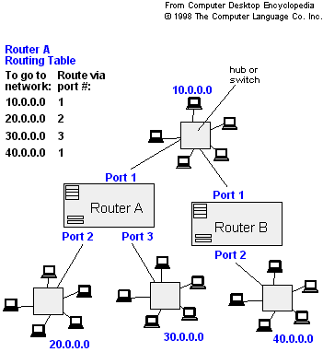
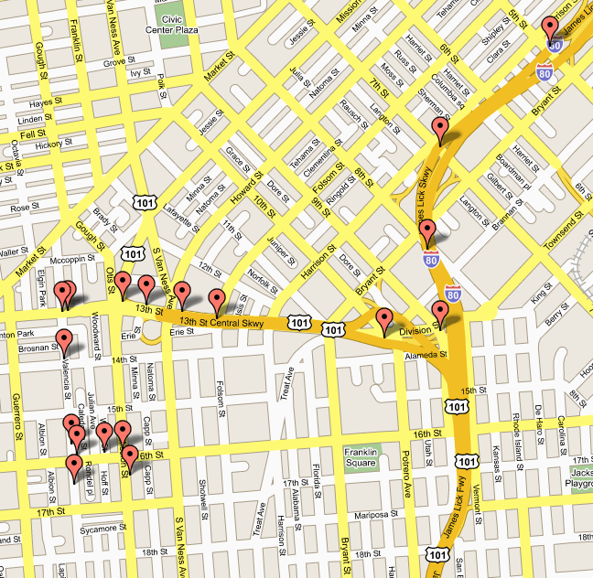
Applications
- Traffic Information Systems are most prominent use
- Mapping (Map Quest, Google Maps)
- Routing Systems

Slide 40
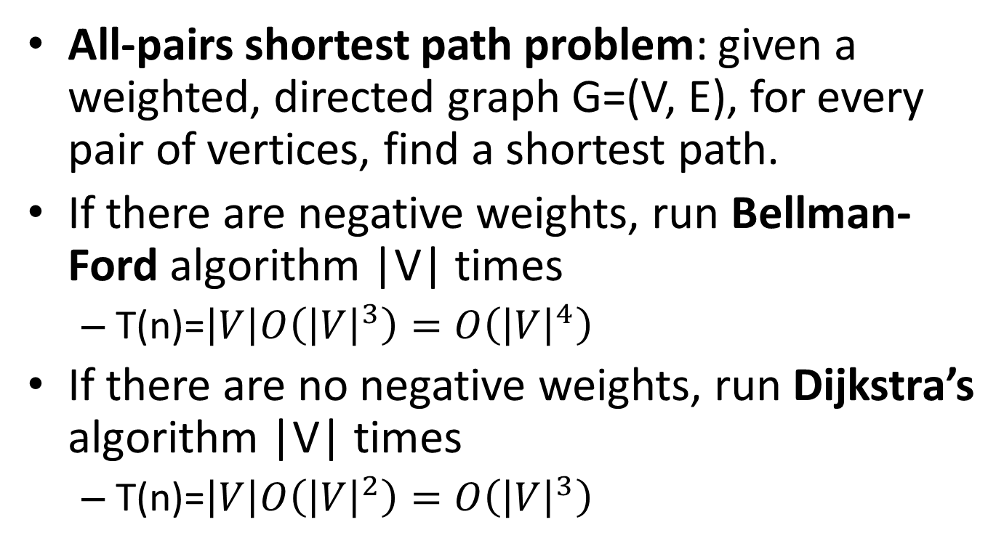
All-pairs shortest paths
All-pairs shortest path problem: given a weighted, directed graph G=(V, E), for every pair of vertices, find a shortest path.
If there are negative weights, run Bellman-Ford algorithm |V| times
T(n)=$\left|V\right|O\left({\left|V\right|}^{3}\right)=O\left({\left|V\right|}^{4}\right)$
If there are no negative weights, run Dijkstra’s algorithm |V| times
T(n)=$\left|V\right|O\left({\left|V\right|}^{2}\right)=O\left({\left|V\right|}^{3}\right)$

Slide 41
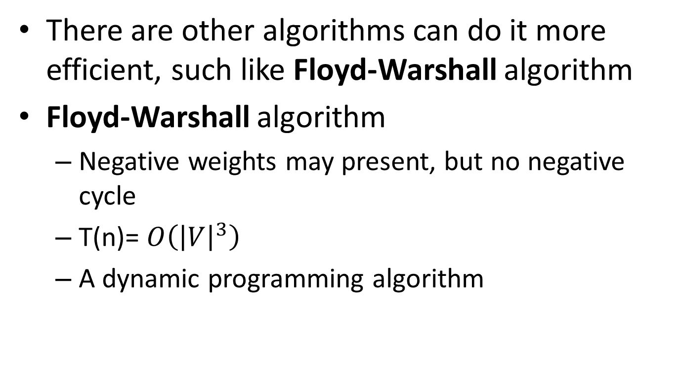
All-pairs shortest paths
There are other algorithms can do it more efficient, such like Floyd-Warshall algorithm
Floyd-Warshall algorithm
Negative weights may present, but no negative cycle
T(n)= $O\left({\left|V\right|}^{3}\right)$
A dynamic programming algorithm

Slide 42
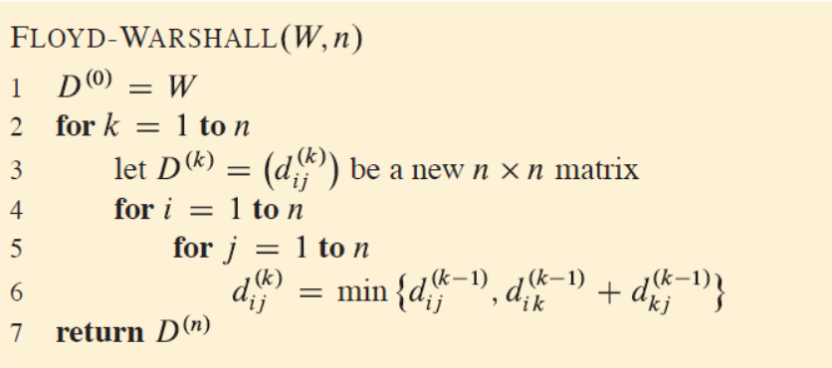
Floyd Algorithm

Slide 43
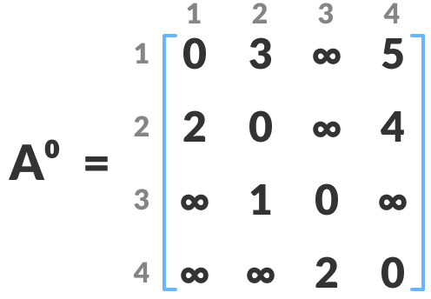
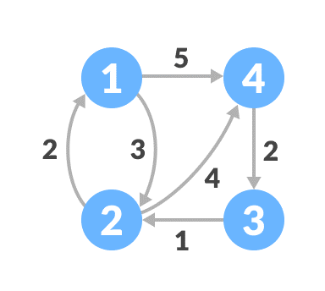
Floyd Warshall
Create a matrix A⁰ of dimension n*n where n is the number of vertices. The row and the column are indexed as i and j respectively. i and j are the vertices of the graph.
Each cell A[i][j] is filled with the distance from the ith vertex to the jth vertex. If there is no path from ith vertex to jth vertex, the cell is left as infinity.

Slide 44
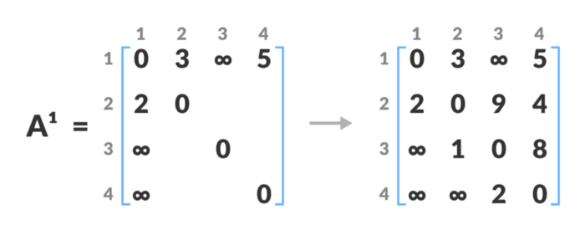
Floyd Warshall
if (A[i][j] > A[i][k] + A[k][j])
Notes:
Now, create a matrix A1 using matrix A0. The elements in the first column and the first row are left as they are. The remaining cells are filled in the following way.
A[i][j] is filled with (A[i][k] + A[k][j] if (A[i][j] > A[i][k] + A[k][j]).

Slide 45
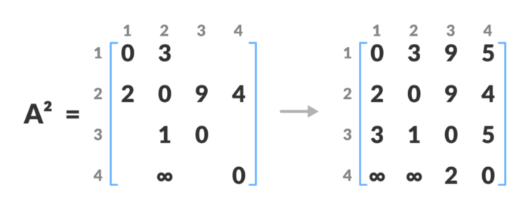
Floyd Warshall
if (A[i][j] > A[i][k] + A[k][j])

Slide 46
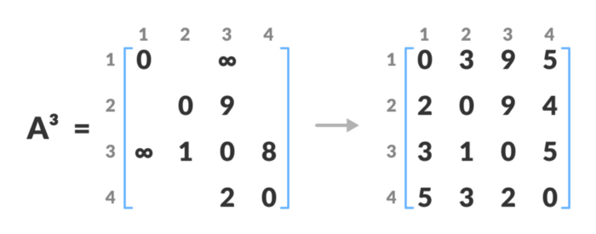
Floyd Warshall
if (A[i][j] > A[i][k] + A[k][j])

Slide 47
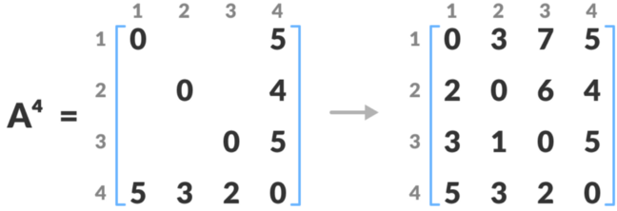
Floyd Warshall
if (A[i][j] > A[i][k] + A[k][j])

Slide 48
Floyd-Warshall Algorithm
The Floyd-Warshall algorithm works based on a property of intermediate vertices of a shortest path.

Slide 49
Floyd-Warshall Example 2
if (A[i][j] > A[i][k] + A[k][j])

Slide 50
Floyd-Warshall Example 2
if (A[i][j] > A[i][k] + A[k][j])

Slide 51
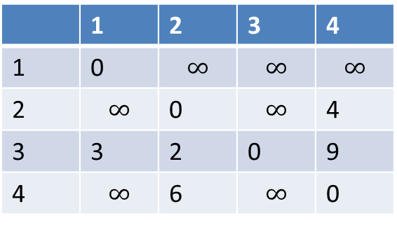
Floyd Warshall (Example 3)
What are the weights of shortest paths with no intermediate vertices, D(0)?
1
2
 | 1 | 2 | 3 | 4
1 | 0 | $$∞$$ | $$∞$$ | $$∞$$
2 | $$∞$$ | 0 | $$∞$$ | 4
3 | 3 | 2 | 0 | 9
4 | $$∞$$ | 6 | $$∞$$ | 0
2
3
6
4
3
4
9

Slide 52


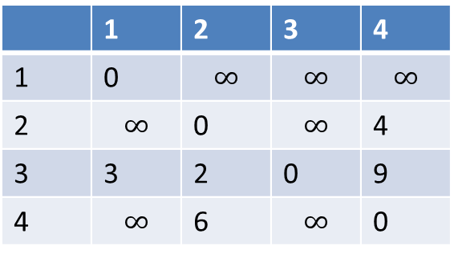






Floyd Warshall (Example)
D(0)
 | 1 | 2 | 3 | 4
1 | 0 | $$∞$$ | $$∞$$ | $$∞$$
2 | $$∞$$ | 0 | $$∞$$ | 4
3 | 3 | 2 | 0 | 9
4 | $$∞$$ | 6 | $$∞$$ | 0
1
2
2
3
6
4
What are the weights of shortest paths with intermediate vertex 1?
3
4
D(1)
 | 1 | 2 | 3 | 4
1
2
3
4
9
0
$$∞$$
$$∞$$
$$∞$$
$$∞$$
0
$$∞$$
4
3
$$2$$
0
9
$$∞$$
6
$$∞$$
0

Slide 53












Floyd Warshall (Example)
D(1)
 | 1 | 2 | 3 | 4
1
2
3
4
0
$$∞$$
$$∞$$
$$∞$$
1
2
$$∞$$
0
$$∞$$
4
3
$$2$$
0
9
2
$$∞$$
6
$$∞$$
0
3
4
6
4
What are the weights of shortest paths with intermediate vertices 1 and 2?
3
4
D(2)
 | 1 | 2 | 3 | 4
1
2
3
4
9
0
$$∞$$
$$∞$$
$$∞$$
$$∞$$
0
$$∞$$
4
3
$$2$$
0
6
$$∞$$
6
$$∞$$
0

Slide 54
















Floyd Warshall (Example)
D(2)
 | 1 | 2 | 3 | 4
1
2
3
4
0
$$∞$$
$$∞$$
$$∞$$
1
2
$$∞$$
$$∞$$
0
4
3
$$2$$
0
6
2
3
$$∞$$
6
$$∞$$
0
6
4
What are the weights of shortest paths with intermediate vertices 1, 2 and 3?
3
4
D(3)
 | 1 | 2 | 3 | 4
1
2
3
4
9
0
$$∞$$
$$∞$$
$$∞$$
$$∞$$
0
$$∞$$
4
3
$$2$$
0
6
$$∞$$
6
$$∞$$
0

Slide 55





Floyd Warshall (Example)
D(3)
 | 1 | 2 | 3 | 4
1
2
3
4
0
$$∞$$
$$∞$$
$$∞$$
1
2
$$∞$$
0
$$∞$$
4
3
$$2$$
0
6
2
$$∞$$
6
$$∞$$
0
3
6
4
What are the weights of shortest paths with intermediate vertices 1, 2, 3 and 4?
3
D(4)
4
 | 1 | 2 | 3 | 4
1
2
3
4
9
0
$$∞$$
$$∞$$
$$∞$$
$$∞$$
0
$$∞$$
4
3
$$2$$
0
6
$$∞$$
6
$$∞$$
0

Slide 56
































Floyd Warshall (Example)
Add predecessor information to reconstruct a shortest path
If updated the predecessor i-j in D(k) is the same as the predecessor k-j in D(k-1)
D(0)
D(1)
 | 1 | 2 | 3 | 4
1
2
3
4
 | 1 | 2 | 3 | 4
1
2
3
4
0/n
$$∞/n$$
$$∞/n$$
$$∞/n$$
0/n
$$∞/n$$
$$∞/n$$
$$∞/n$$
$$∞/n$$
0/n
$$∞/n$$
4/2
$$∞/n$$
0/n
$$∞/n$$
4/2
3/3
$$2/3$$
0/n
9/3
3/3
$$2/3$$
0/n
9/3
$$∞/n$$
6/4
$$∞/n$$
0/n
$$∞/n$$
6/4
$$∞/n$$
0/n
D(2)
D(3)
 | 1 | 2 | 3 | 4
1
2
3
4
 | 1 | 2 | 3 | 4
1
2
3
4
0/n
$$∞/n$$
$$∞/n$$
$$∞/n$$
0/n
$$∞/n$$
$$∞/n$$
$$∞/n$$
$$∞/n$$
0/n
$$∞/n$$
4/2
$$∞/n$$
0/n
$$∞/n$$
4/2
3/3
$$2/3$$
0/n
6/2
3/3
$$2/3$$
0/n
6/2
$$∞/n$$
6/4
$$∞/n$$
0/n
$$∞/n$$
6/4
$$∞/n$$
0/n

Slide 57








Floyd Warshall (Example)
D(4)
1
2
 | 1 | 2 | 3 | 4
1
2
3
4
0/n
$$∞/n$$
$$∞/n$$
$$∞/n$$
2
$$∞/n$$
4/2
3
$$∞/n$$
0/n
6
4
3/3
$$2/3$$
0/n
6/2
$$∞/n$$
6/4
$$∞/n$$
0/n
3
4
9
What is the shortest path from 3 to 4?
3, 2, 4
What is weight of this path?
6

Slide 58
Remarks
Dijkstra’s algorithm is a single source one
Bellman’s algorithm consider negative weights but for acyclic graphs
Floyd’s algorithm solves for the shortest path among all pairs of vertices.

Slide 59
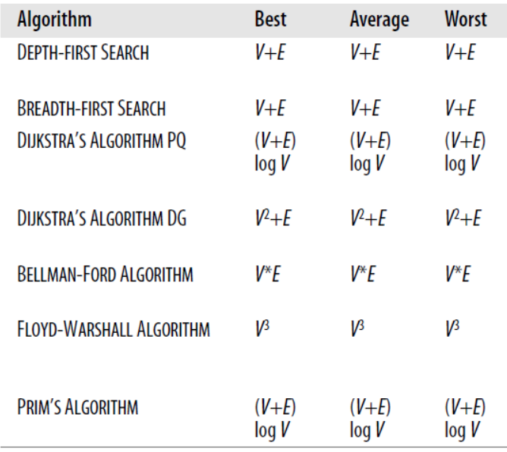
Graph algorithms Complexities

